Slide 1
TCP/IP Computer Networks Performance Metrics
José Legatheaux Martins
Departamento de Informática da
FCT/UNL

Slide 2
Lecture Outline
Queuing Model
Generic Performance Metrics
Components of Hop and End-to-End Packet Delay
More Performance Measures
Tools
Using slides from the companion site of
James F. Kurose and Keith W. Ross, “Computer Networking - A Top-Down Approach Featuring the Internet,” Addison Wesley

Slide 3
Computer Networks
T
X
Z
W1
W2
W
Y
Host
L
AP
W3
Host
M
Host
A
2
3
W4
links
4
Host
B
1
5
nodes
14
16
11
Host
J
Host
C
12
17
15
6
10
13
7
Host
H
Host
D
9
8
Host
G
Host
E
Host
F

Slide 4
Link Performance Measures
Throughput or link capacity - bits/sec. successfully sent [e.g. Throughput = 10 Mbps]
Error rate – the fraction of bits correctly received over sent ones [e.g. Error rate = 10⁻⁹]
Propagation delay — time a bits takes to travel across the link [e.g. Prop. delay = 10 ms]
Link utilization - the average fraction of time a link is busy [e.g. Utilization = 0.8]
when overhead is taken into account (i.e., it is excluded from the useful bits sent), link utilization is often referred to as link efficiency.

Slide 5
Simple Queuing Model
Customer
Arrivals
Queue
Server

Slide 6
Router Node
node
Outgoing Link
packet
Incoming Link
Server
packet
Router Buffer

Slide 7
Queuing Metrics
Utilization (taxa de utilização)
the percentage of time a device is busy servicing a “customer”.
Throughput (desempenho)
the number of jobs processed by the “system” per unit time.
Response time (tempo de resposta)
the time required to receive a response to a request (round-trip time (RTT) ).
Delay (atraso)
the time to traverse from one end to the other of a system.

Slide 8
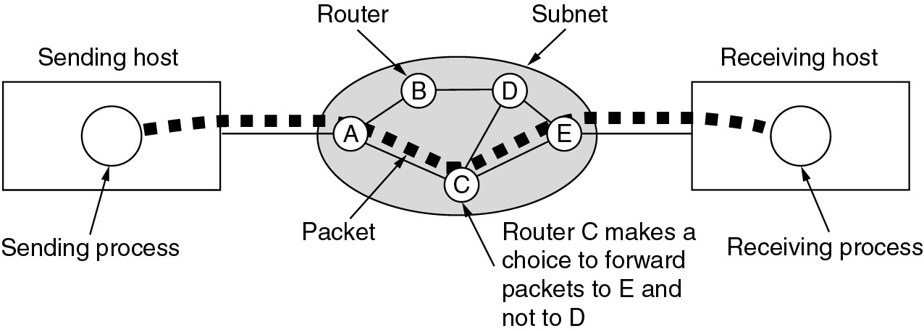
End-to-End Packet Delay
End-to-end delay includes multiple hop link delays.

Slide 9
Hop Delay Components
transmission
A
propagation
B
nodal
processing
queueing
d_{nodal} = d_{proc} + d_{queue} + d_{trans} + d_{prop}

Slide 10
Nodal Delay
d_{proc} = processing delay
typically a few microsecs or less
d_{queue} = queuing delay
depends on congestion
d_{trans} = transmission delay
= L/R, significant for low-speed links
d_{prop} = propagation delay
a few microsecs to hundreds of msecs

Slide 11
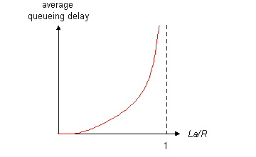
Queuing Delay
R=link bandwidth (bps)
L=packet length (bits)
a=average packet arrival rate
traffic intensity = La/R
La/R ~ 0: average queuing delay small
La/R -> 1: delays become large
La/R = or > 1: more “work” arriving than can be serviced, average delay infinite!

Slide 12
Implementation: Packet drop
Queue (aka buffer) preceding link in buffer has finite capacity.
Packet arriving to full queue is dropped (aka lost) [FIFO Drop Tail router].
Lost packet may be retransmitted by previous node, by source end system, or not at all.
buffer
(waiting area)
packet being transmitted
A
B
packet arriving to
full buffer is dropped.

Slide 13
Network Path Performance Measures
End-to-end delay
Delay from source to destination. Measured from when the sender starts sending a packet up to when the receiver completely receives the packet
Latency
Usually implies the minimum possible delay. Latency assumes no queuing and no contention encountered along the path.
Jitter
Variance of end-to-end delay.

Slide 14
More
Packet loss rate
the percentage of packets lost or dropped.
Goodput
{measured at the receiver} The rate in bits per second of useful traffic received. Goodput excludes duplicate packets and packets dropped along the path.
Fairness
either Jain’s fairness or max-min fairness are used to measure fair treatment among competing flows.
Quality of Service (QoS)
a QoS measure accounts for importance of specific metric to one type of application [e.g. jitter and playable frame rate for streaming media].

Slide 15
Throughput / Goodput
throughput — rate (bits/time unit) at which bits are transferred between sender/receiver
instantaneous: rate at given point in time
average: rate over longer period of time
server, with
file of F bits
to send to client
server sends bits
(fluid) into pipe
pipe that can carry
fluid at rate
R_{s} bits/sec)
pipe that can carry
fluid at rate
R_{c} bits/sec)
link capacity
R_{s} bits/sec
link capacity
R_{c} bits/sec

Slide 16
Throughput (more)
R_{s} < R_{c} What is average end-end throughput?
R_{s} bits/sec
R_{c} bits/sec
R_{s} > R_{c} What is average end-end throughput?
R_{s} bits/sec
R_{c} bits/sec
bottleneck link
link on end-end path that constrains end-end throughput

Slide 17
Throughput: Internet Scenario
per-connection end-end throughput: min(R_{c},R_{s},R/10)
in practice: R_{c} or R_{s} is often the bottleneck
The last mile link has capacity Rc.
R_{s}
R_{s}
R_{s}
R
R_{c}
R_{c}
R_{c}
10 connections (fairly) share backbone bottleneck link R bits/sec

Slide 18
Wireless Links Performance Metrics
WLANs and WSNs are very concerned with
packet loss and employ additional metrics:
Delivery ratio
the ratio of packets received to packets sent {excluding duplicates and retransmissions}.
Link layer retransmission rates
the percentage of DL layer frames that are retransmitted.

Slide 19
Tools
Useful tools:
Ping
iperf
Traceroute
tcpdump
wireshark
and many others
Look into Wikipedia

Slide 20
Performance Metrics Summary
The three most general performance measures are : utilization, throughput and response time.
In computer networks, end-to-end delay is an important performance metric.
Queuing models are used to analyze and estimate computer network performance.
Other useful metrics include: latency, goodput, fairness and QoS metrics such as jitter.
In wireless networks, delivery ratio, packet loss rate and link layer retransmission rates are valuable network measures.

